Slide 1
Missing Data in International Merchandise Trade Statistics (IMTS) Causes, Consequences, and Solutions By Tigran Terlemezian, GCC-STAT
International Workshop on Updated Recommendations in the Trade Statistics Manuals - IMTS 2026 and MSITS 2026
Organized jointly by GCC-Stat and UNSD
Muscat, Oman, 14-16 April 2025

Slide 2
Outline of The Presentation
Introduction
What is Missing Data?
Causes of Missing Data in IMTS
Types of Missing Data (Statistical Perspective)
Missing Completely at Random (MCAR)
Missing at Random (MAR)
Missing Not at Random (MNAR)
Data Cleaning by Type of Missingness
Structured Missingness (SM)
Examples
Data Cleaning Solutions
Summary of Missing Data Types
Impacts of Missing Data
Detection of Missing Data
Approaches to Handle Missing Data
Best Practices and Recommendations
Conclusion
References / Resources

Slide 3
Introduction
What is IMTS?
Records the exports and imports of goods between countries.
Essential for economic analysis, trade policy, business planning, and international comparisons.
Why Data Completeness and Quality Matter
Reliable trade statistics support sound decisions.
Missing or poor-quality data can lead to inaccurate insights and flawed policies.

Slide 4
What is Missing Data?
Definition:
Data that should be recorded but is absent or not captured in the dataset.
Types of missing data:
Completely Missing
Entire records are absent from the dataset.
Partially Missing
Only some fields are missing, such as HS codes, partner country, or trade values.
Systematically Missing
Data gaps follow a known pattern—often from specific countries or time periods.

Slide 5
Causes of Missing Data in IMTS
Reporting Errors or Delays
Late or incorrect submissions by customs or national statistical offices.
Data Suppression for Confidentiality
Certain trade data withheld to protect sensitive commercial information.
Lack of Capacity in Developing Countries
Limited resources, infrastructure, or expertise to collect and process trade data.
Technical Issues
System incompatibilities, transmission failures, or software malfunctions affecting data flow.
Differences in Trade Reporting Standards
Variations in definitions, valuation, or timing across countries lead to inconsistencies.

Slide 6
Types of Missing Data
Types of Missing Data (Statistical Perspective)
Classical framework
Reflected in the Chapiter X. Data Compilation Strategies, B. Missing data
Missing Completely at Random (MCAR):
Missingness occurs purely by chance and is unrelated to any data.
Missing at Random (MAR):
Missingness depends only on observed variables, not on the missing values themselves.
Missing Not at Random (MNAR):
Missingness depends on unobserved data or the missing values themselves.
Structured Missingness (SM)
Data is missing in systematic patterns due to study design or data collection structure. (Characterizing structured missingness within the classical framework of MCAR, MAR, and MNAR is a work in progress, and not yet reflected in the IMTS -2026, Chapter X)

Slide 7
Missing Completely at Random (MCAR)
Definition: MCAR occurs when the probability that data is missing is completely unrelated to:
The missing values themselves, and
Any other variables in the dataset.
➡️ The missingness is entirely random.
Example: Suppose the weight of imported goods is sometimes accidentally left blank during manual data entry. ➡️ These omissions are not related to:
The type of goods
Their value
The country of origin (e.g., human error)
➡️ Just pure chance
✅ Implication:
Statistical analysis remains unbiased if MCAR holds
But reduces data efficiency (i.e., smaller usable sample)

Slide 8
Missing Completely at Random (MCAR)
Definition: MCAR occurs when the probability that data is missing is completely unrelated to:
The missing values themselves, and
Any other variables in the dataset.
➡️ The missingness is entirely random.
Example: Suppose the weight of imported goods is sometimes accidentally left blank during manual data entry. ➡️ These omissions are not related to:
The type of goods
Their value
The country of origin (e.g., human error)
➡️ Just pure chance
✅ Implication:
Statistical analysis remains unbiased if MCAR holds
But reduces data efficiency (i.e., smaller usable sample)

Slide 9
Missing at Random (MAR)
Missingness can be modeled and corrected using known variables
This makes imputation or analysis more robust than MCAR
Definition: MAR occurs when the probability of missing data is related to observed variables, but not to the missing data itself.
➡️ The missingness is systematic, but can be explained using data that is already available.
Example: A dataset of imported goods contains missing values for import prices, and these missing values are more likely to occur for specific countries of origin.
✅ This suggests the issue is due to:
Differences in reporting practices
National data collection procedures
But not due to the value or type of the goods
📌 Key Point:
Missingness can be modeled and corrected using known variables
This makes imputation or analysis more robust than MCAR

Slide 10
Missing Not at Random (MNAR)
Definition: MNAR occurs when the probability that data is missing depends on the missing values themselves, or on unobserved factors not included in the dataset.
➡️ The missingness is not explainable by any known or observed variable.
Example: In trade data, if high-value imports are more likely to be missing from records, because importers intentionally underreport or withhold them to avoid taxes or duties.
✅ The missingness depends on the true (but unobserved) value of the goods — making it MNAR.
🚨 Why It’s Challenging:
Bias is introduced because missingness is non-random and unobservable
Statistical corrections require domain knowledge or external information
Imputation is risky and often unreliable without assumptions
📌 Key Insight: Handling MNAR typically requires advanced modeling, expert knowledge, or supplemental data — sometimes even policy changes to improve reporting.

Slide 11
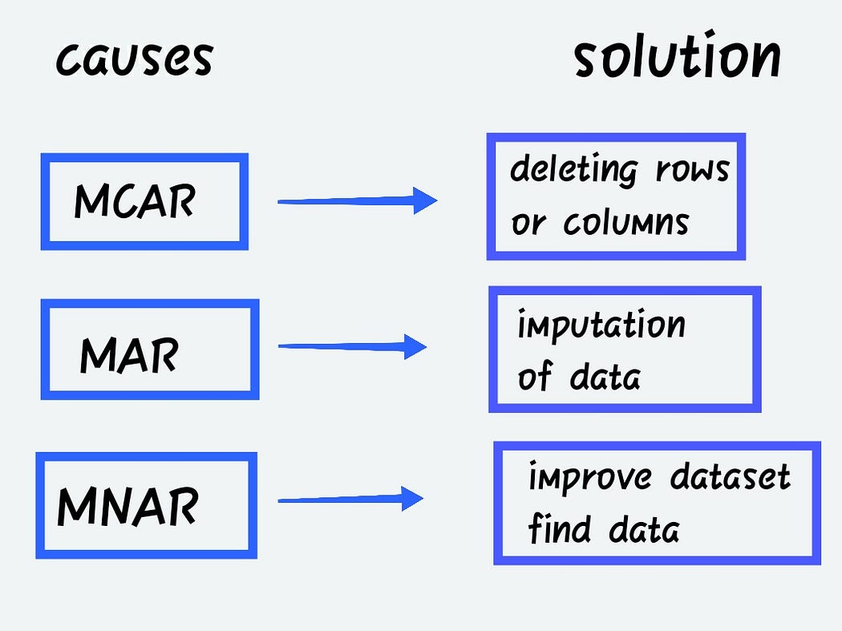
Data Cleaning by Type of Missingness
Techniques to use while handling missing data for three classical causes of missingness or missing data| by Keerti Prajapati:

Slide 12
Structured Missingness (SM)
Definition: Data that are missing from the datasets for a valid reason are called structured missing data or structured missingness (SM). This means the data are missing because they should not occur considering the other variables. SM refers to non-random, patterned missing data that doesn't neatly fit into the classical categories of MCAR, MAR, or MNAR.
SM has been pioneered by researchers of the Turing-Roche Partnership. SM arises in data that is MCAR, MAR or MNAR, and whose missingness has some structure or pattern Mitra et al., 2023.
➡️ It often arises in complex or integrated datasets, where missingness is inherent to the structure of the data collection process.

Slide 13
Structured Missingness (SM), Cont.
🔍 Why It Matters:
Standard imputation or statistical approaches may fail to account for structure
Can introduce bias, especially in machine learning models
Impacts:
Predictive fairness
Generalizability of findings
Scalability of data-driven methods
⚠️ Challenges:
Difficult to classify within MCAR/MAR/MNAR
Existing theory lags behind practice
Needs new formulations and frameworks to handle this type of missingness effectively)
💡 Takeaway: Structured missingness is informative, patterned, and increasingly common in large, integrated datasets — demanding new methods beyond classical missing data theory.

Slide 14
Structured Missingness: Examples
Examples | Description | Why it’s structured missingness
Example 1: Non-applicable Product Categories | A country that is landlocked (no access to the sea) would not have data for seaborne exports/imports of marine vessels. | The data are missing because they are not applicable—the country doesn't engage in that type of trade due to geographic constraints.
Example 2: Trade Restrictions or Embargoes | If a country has a trade embargo or sanctions against another country, there will be no recorded merchandise trade with that country during the embargo period. | The absence of trade data is due to a known policy or legal constraint, not due to random chance or error.
Example 3: Product-Specific Regulations | Some products (e.g., nuclear materials, military goods) may only be traded under very specific conditions and may not appear in regular trade data. | These items are regulated or restricted and may be legally excluded from standard reporting.
Example 4: Non-participation in Specific Agreements | A country may not be part of a regional trade agreement (like the EU or USMCA), so certain preferential trade flows or data classifications do not apply. | The missing data are due to the country’s non-membership status, not due to reporting errors or omissions.

Slide 15
SM: Data Cleaning Solutions
Recommended Data Cleaning Solutions for Structured Missingness
1. Identification of the Structure of Missingness
Visualization of missing data patterns (e.g., heatmaps, missingness matrices).
Group-wise analysis to see if missingness is associated with specific countries, HS codes, or time periods.
2. Data Imputation (With Domain Knowledge)
Group Mean/Median Imputation: Replacing missing values using averages within a group (e.g., by country or product category).
Last Observation Carried Forward (LOCF): For time-series data, carrying forward the last known value.
Model-Based Imputation: Using regression models or machine learning to predict missing values based on other variables.
Multiple Imputation: Generating several imputed datasets to reflect uncertainty and then average results.
3. Using Auxiliary Data Sources
Pulling from alternative databases (e.g., WTO, UN Comtrade) to fill in gaps.
Using mirror statistics (e.g., if imports are missing for country A, look at exports from country B to A).

Slide 16
SM: Data Cleaning Solutions, Cont.
Recommended Data Cleaning Solutions for Structured Missingness, continued
4. Flagging and Annotating Structured Missingness
Clearly tagging missing fields with metadata indicating reason (e.g., embargo, reporting gap).
Helping future users interpret the data accurately.
5. Data Aggregation
If detailed level data are missing, to consider aggregating up to a higher level (e.g., from 6-digit HS to 4-digit).
Preserves usability even if detailed resolution is partially missing.
6. Time-Series Interpolation
Applying linear, spline, or Kalman filter interpolation for filling in structured time-series gaps.
7. Sensitivity Testing
Conducting sensitivity analysis to check how results change with different imputation strategies.
8. Documentation
Documenting (MUST) assumptions, methods, and limitations clearly.

Slide 17
Summary of Missing Data Types
Missingness Type | Definition | Missingness Depends On | Example | Implications
MCAR (Missing Completely at Random) | Data is missing for no identifiable reason | Nothing (neither observed nor unobserved data) | Random omission of weights due to data entry error | Least biased; analysis remains valid
MAR (Missing at Random) | Missingness relates to observed data | Observed variables | Value missing more often for certain countries | Imputation feasible using observed data
MNAR (Missing Not at Random) | Missingness depends on the missing data itself or unobserved variables | Unobserved or the missing variable itself | High-value imports not reported to evade taxes | Most biased; hard to model or correct
Structured Missingness | Missingness follows a pattern based on data source/design | Study design, modality, or data collection structure | Linked datasets (e.g., clinical + genomic) where variables differ by source | Needs new methods; not well captured by classical theory

Slide 18
Impacts of Missing Data
Skewed Trade Balances & Misleading Trade Patterns
Missing data can distort import/export totals, leading to incorrect interpretations of trade dynamics.
Inaccurate Macroeconomic Indicators
Key metrics like GDP, trade-to-GDP ratios, or balance of payments may be misestimated.
Impacts on Policy Decisions & Market Analysis
Poor data quality weakens evidence-based policymaking and hampers accurate market forecasts.
Loss of International Comparability
Inconsistent reporting across countries reduces the reliability of global trade comparisons.

Slide 19
Detection of Missing Data
Data Validation Tools (UN Comtrade, National Systems) Automated checks to identify errors, inconsistencies, or gaps during data entry or submission.
Time Series Analysis to Detect Anomalies Identifies unexpected fluctuations or gaps in trade flows over time that may indicate missing data.
Partner Data Comparison (Mirror Statistics) Cross-checking trade data with partner countries to detect and estimate missing or misreported values.
Use of Metadata and Flags to Indicate Missingness Clear documentation helps users identify and interpret gaps or imputed values in trade datasets.

Slide 20
Handling Missing Data
Approaches to Handle Missing Data
Imputation methods:
Techniques to fill in missing values using statistical or algorithmic approaches.
Mean/Median Substitution
Replacing missing values with the average or median of available data.
Regression Methods
Prediction of missing values using relationships with other observed variables.
Machine Learning Approaches
Use of algorithms (e.g., random forest, k-NN) to learn patterns and estimate missing data.
Using mirror data
Estimation of missing trade values based on partner country reports.
Estimation models based on historical trends
Use of past trade patterns to forecast and fill in current missing data.
Flagging and documentation rather than imputation in some cases.
Clear marking of missing values with metadata, allowing users to interpret gaps transparently.

Slide 21
Best Practices & Recommendations
Capacity Building in Statistical Agencies
Enhancing skills, tools, and infrastructure for accurate data collection and processing.
Improving Metadata and Documentation
Providing detailed, transparent notes on data sources, methods, and limitations.
Harmonization of Reporting Practices
Aligning definitions, classifications, and formats across countries for consistency.
Regular Data Quality Audits & Cross-Country Validations
Periodic checks and comparisons to identify and correct discrepancies.

Slide 22
Best Practices & Recommendations
Capacity Building in Statistical Agencies
Enhancing skills, tools, and infrastructure for accurate data collection and processing.
Improving Metadata and Documentation
Providing detailed, transparent notes on data sources, methods, and limitations.
Harmonization of Reporting Practices
Aligning definitions, classifications, and formats across countries for consistency.
Regular Data Quality Audits & Cross-Country Validations
Periodic checks and comparisons to identify and correct discrepancies.

Slide 23
Conclusion
Conclusion: Addressing Missing Data in Trade Statistics
Missing data matters — it affects accuracy, comparability, and policy relevance of trade statistics.
Collaboration, transparency, and innovation are key to improving data quality and managing gaps effectively.
Continued research and capacity-building are essential to adapt to evolving data challenges and support better decision-making..

Slide 24
References
IMTS-2026 Draft Chapters - April 2025, X. Data Compilation Strategies, B. Missing data, Task-Team on International Trade Statistics, April 2025
Missing data, Wikipedia, https://en.wikipedia.org/wiki/Missing_data
Censoring (statistics), Wikipedia, https://en.wikipedia.org/wiki/Censoring_(statistics)
Learning from data with structured missingness, 2023, https://www.nature.com/articles/s42256-022-00596-z
Data cleaning: Types of Missingness, by Keerti Prajapati, May 26, 2020, https://medium.com/@codingpilot25/data-cleaning-types-of-missingness-40655a8b235e
Interpolation in Time Series: An Introductive Overview of Existing Methods, Their Performance Criteria and Uncertainty Assessment, MDPI (Multidisciplinary Digital Publishing Institute), 17 October 2017, https://www.mdpi.com/2073-4441/9/10/796
Structural Time Series Models and the Kalman Filter: A Concise Review, by João Tovar Jalles, University of Lisbon, June 2009, https://papers.ssrn.com/sol3/papers.cfm?abstract_id=1496864
THANK YOU!

